Slide 1

Identifying A Location for A New Restaurant In New York (Queens)

Slide 2
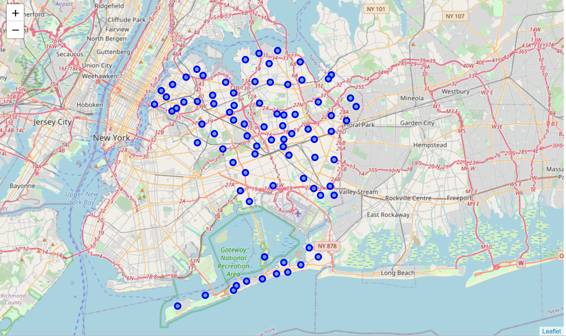
Identifying the best neighborhood(s) to open a new restaurant reduces risk
The restaurant industry is a high-risk business.
It helps to place the restaurant in a neighborhood with high visibility and traffic but low eateries saturation
The data required includes New York neighborhood data (https://cocl.us/new_york_dataset) and Foursquare data on eateries in the neighborhoods.
With the cluster analysis, the neighborhood(s) with a saturated eatery market are expected to appear together in a cluster while the others will offer possible options for the right neighborhood(s) for the new restaurant.

Slide 3
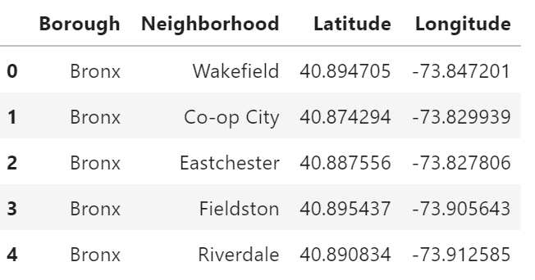
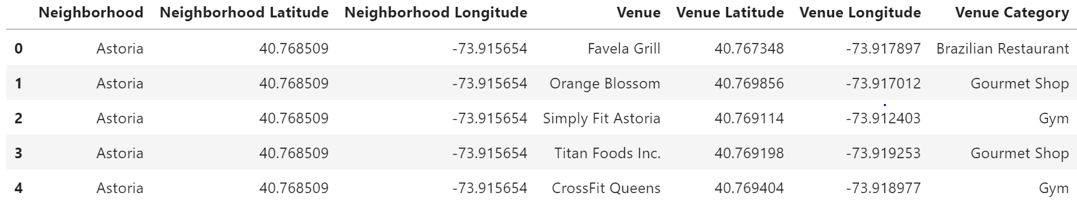
Data Sources
The NYU Spatial Data Repository’s 2014 New York City Neighborhood Names data has information on the 5 borough and 306 neighborhood that make up the city.
It includes the longitudes and latitudes of each of the neighborhoods.
With the Foursquare APIs, the neighborhoods coordinates will be used to identify surrounding venues in these neighborhoods.
The venues include details on the categories which will inform whether a neighborhood is highly trafficked but not saturated by restaurants.

Slide 4
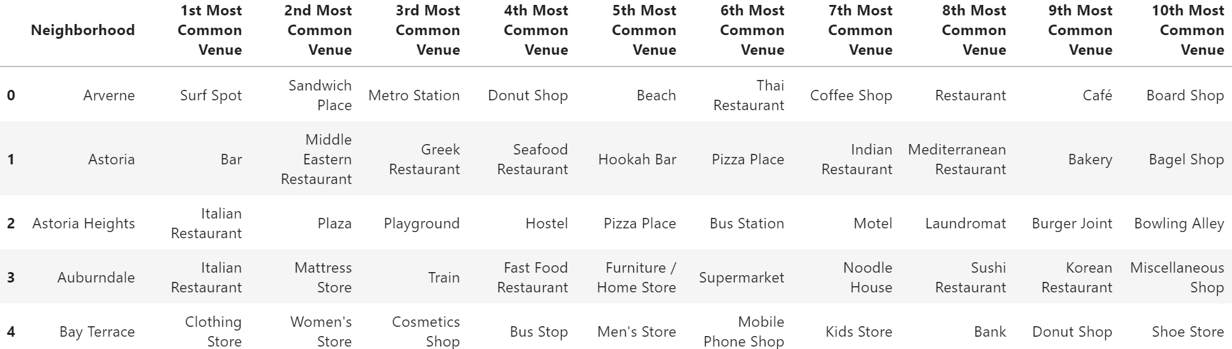
Data Cleaning
New York City neighborhoods data as of 2014.
‘Features’ category
Borough, Neighborhood, Longitude, and Latitude
Five boroughs and 306 neighborhoods.
Filtered dataframe to only include neighborhoods in Queens.
The data was clean without missing values or concerns about outlier and inconsistencies.
The Foursquare data on the surrounding neighborhoods was extracted using an API call on the coordinates
Avoided overloading the call request (radius=500, limit=100)
Grouped by the respective neighborhoods
Used one hot encoding. The categories were indexed by the neighborhood so that each venue category was displayed as a column and each neighborhood as row
Transformed data to show the mean of the frequency of the occurrence of each venue category per neighborhood
Both the spatial data on Queens and the Foursquare data on the nearest and most common venues were joined for the clustering process.

Slide 5
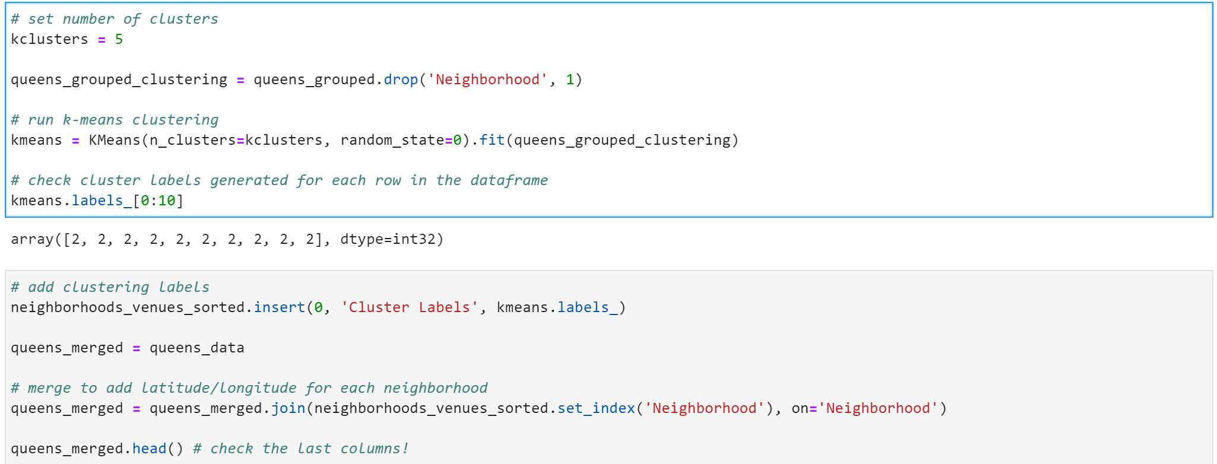
Methodology
Following the data cleaning there were 40 neighborhoods and 330 venues ready for clustering.
k-means from the clustering stage (from sklearn.cluster import KMeans)
Initial run, the k-means was set to five to get five different clusters. Each neighborhood is assigned a cluster of zero to four to determine its cluster group.
The cluster results with the venues is then joined to the neighborhood data which includes the information on the borough and the coordinates.

Slide 6
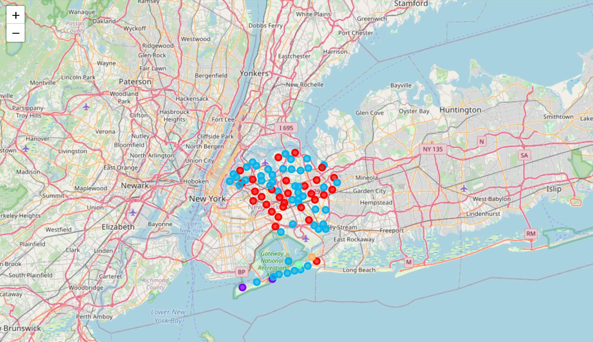
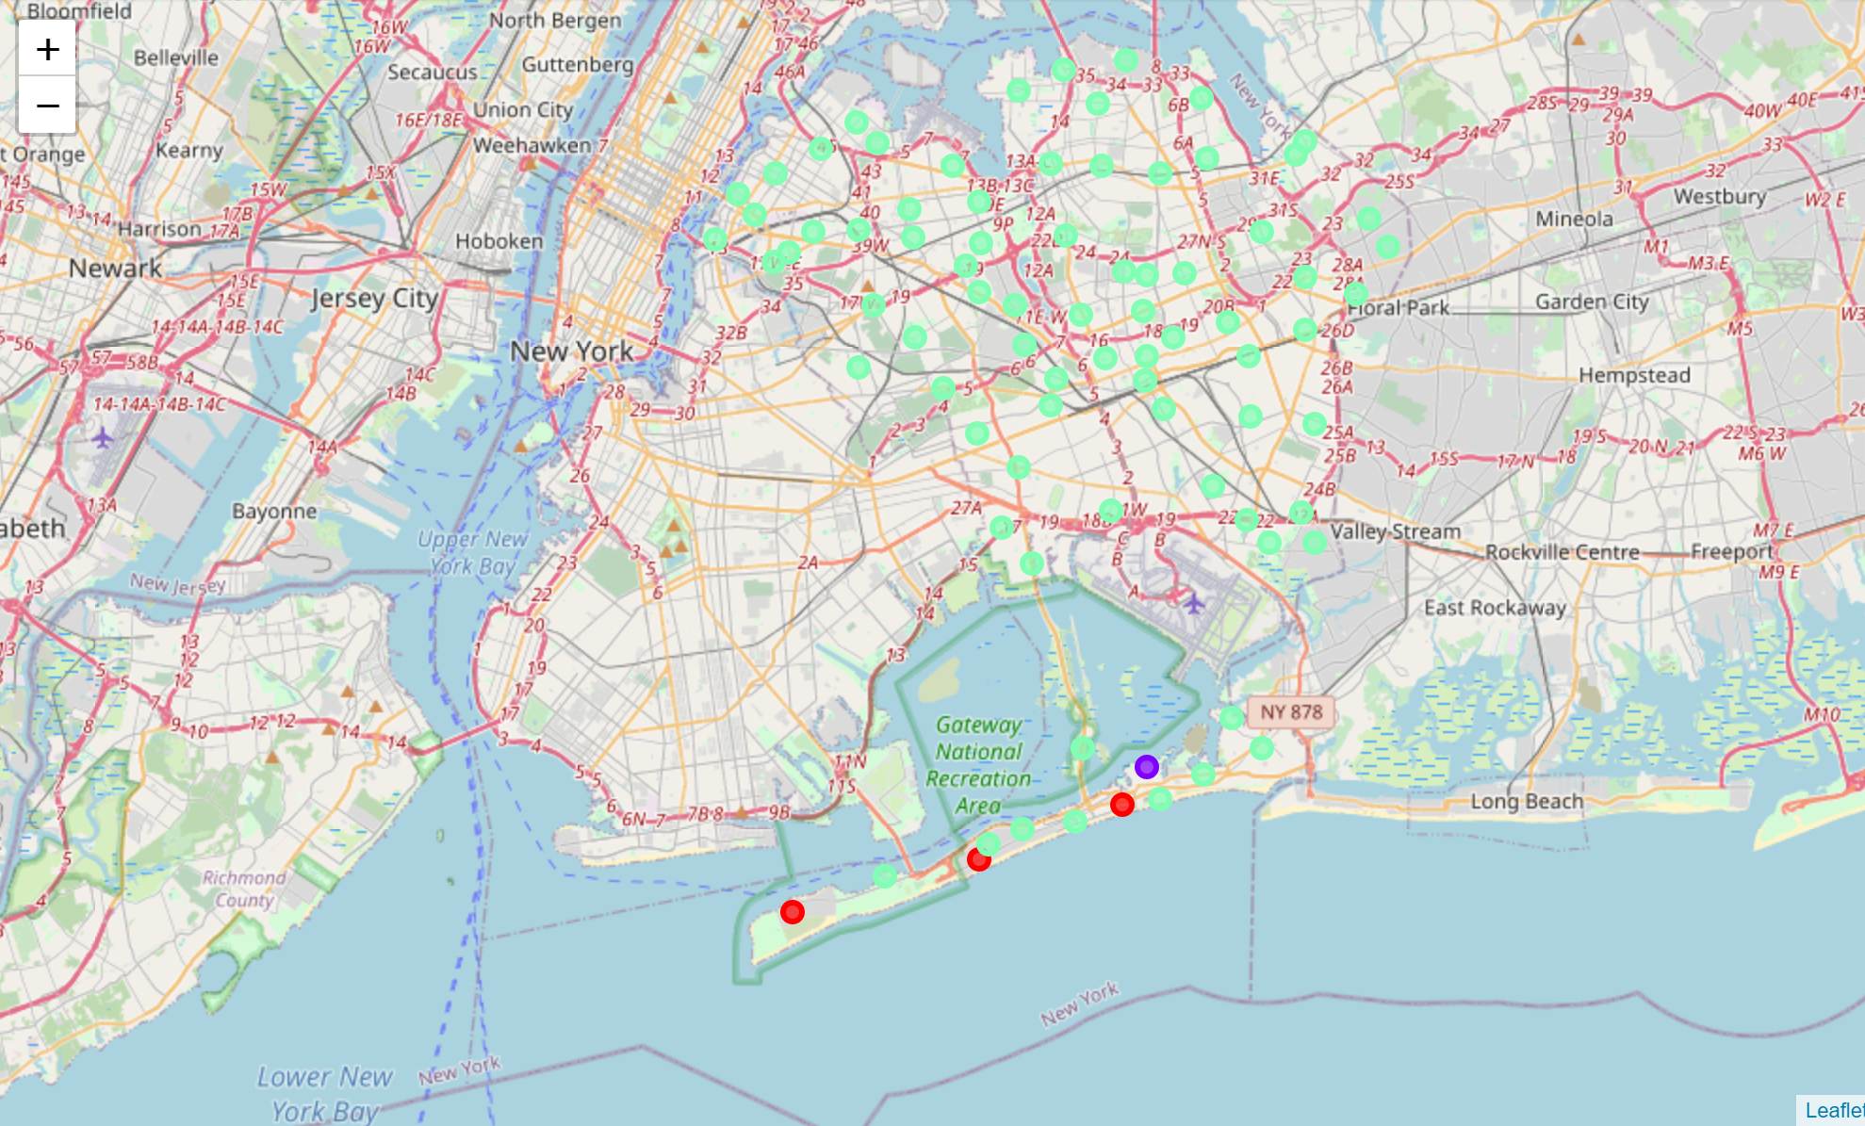
Result
The examination revealed inconclusive clusters for determining the right neighborhood(s)
Too many clusters for the neighborhoods and therefore the k-means should be reduced
Objective was to have a stand out cluster that was not like the rest
k-means was updated to three for the development of three clusters
The three clusters included the following:
Cluster One: Breezy Point, Neponsit, and Hammels neighborhoods. Most common venue was the beach.
Cluster Two: Only includes the Somerville neighborhood with the park as the most common venue.
Cluster Three: High concentration of restaurants which include Mexican, Italian, Thai and Latin American.

Slide 7
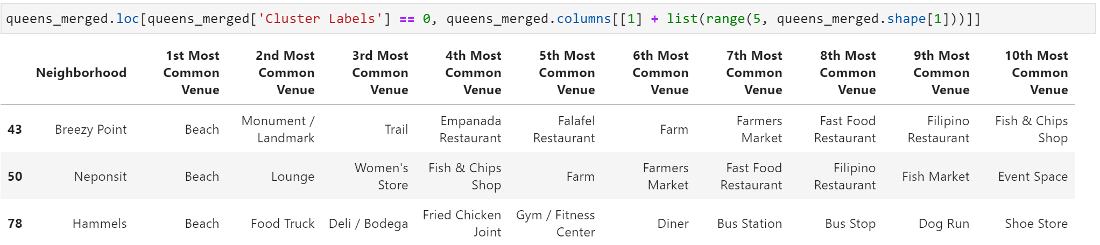
Discussion
Each of the three clusters have eateries represented in the top five most common venues which is a positive representation of the Queens area as a welcoming market for eateries. However, the distinguishing factor across the clusters is the type of eateries and surrounding non-eatery venues.
Cluster One: Low saturation of eateries but highly trafficked
Cluster Two: Medium concentration of restaurants
Cluster Three: High concentration of eateries
Low proportion of eateries to non-eateries shows a great opportunity to distinguish the new restaurant from the other eateries in the area
Considering that the client will be opening a Ghanaian-inspired restaurant having a neighborhood with few non-American options will make it a standout in the neighborhood.

Slide 8
Conclusion
In this study, we analyzed New York city neighborhoods, specifically Queens, to determine the best neighborhoods to open a brand-new Ghanaian-inspired restaurant.
We took a look at the neighborhood data to determine which neighborhoods made up the Queens borough and mapped out their respective coordinate to visualize their locations.
We then transformed the Foursquare data into a dataframe which included the top ten venues across each of these neighborhoods.
We then run a k-means cluster analysis to group the neighborhood into what turned out to be three informative clusters.
The cluster chosen, cluster one, will be presented to the client to help her determine where in Queens to place the first of many restaurants.
The clustering model can be replicated for any other restauranteurs interested in opening a restaurant in New York city.

